Slide 1




A Web Based Efficient Content
Management System
Of
Assam Downtown University
BTech CTIS
6th Semester, 2023
Under the Guidance of :
Mr. Kishore Medhi
Assistant Professor,
Computer Science & Engineering
Presented By :
Sakib Rahman
ADTU/2020-24/BTech(CTIS)/001
Simran Malakar
ADTU/2020-24/BTech(CTIS)/011

Slide 2
CONTENTS
1
Introduction
4
Methodology
2
Objective
5
Features
3
Problem Statement
6
Comparision

Slide 3
INTRODUCTION
Content Management Systems (CMS) are software tools that help individuals and organizations manage digital content such as text, images, videos, and documents.
CMSs are widely used in website and application development, as they provide an efficient and organized way to create, edit, and publish content.

Slide 4

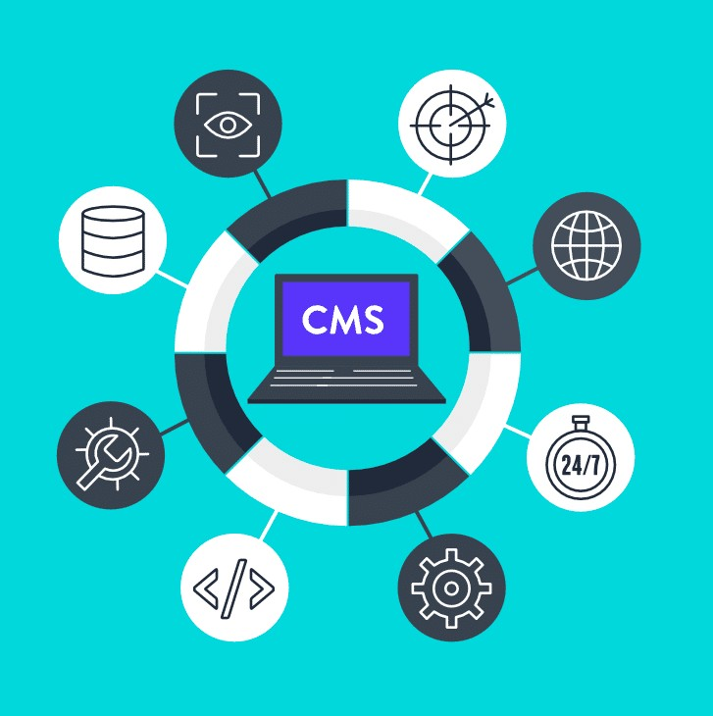
OBJECTIVE
User – Friendly Interface
SEO
Multi – Platform Support
Content Creation, Editing and Publishing

Slide 5



PROBLEM STATEMENT
Multiplate Platforms
Technical Expertise
Manual & Time Consuming
Security & Access Control

Slide 6

METHODOLOGY
Requirement Gathering
Development
Testing Documentation
Design & Architecture
Technology Selection
A
B

Slide 7
FEATURES
Clean & Smooth Interface
Multiple Admin adding Features
User & Admin Profile
Like & Comment Features
Theme Changes (Light / Dark)
Fully Functionable Dashboard for admin
Fast and Less Time Consuming
SEO Friendly
Multiple Platform Support etc.

Slide 8

COMPARISON
CMS
Other
Our
Multi Platform Support
Technical Expertise
Time-Consuming
Security
Controls
No
Required
More time
Less Secure
Over Website
Yes
No Required
Less Time
More Secure
Full Control

Slide 9
What is CMS ?
Objective of CMS
Problem Statement of CMS Methodology
Features
Comparison
CONCLUSION

Slide 10
REFERENCE
WordPress. (n.d.). About WordPress. Retrieved from https://wordpress.org/about/
Joomla. (n.d.). About Joomla. Retrieved from https://www.joomla.org/about- joomla.html
Drupal. (n.d.). About Drupal. Retrieved from h ttps://www.drupal.org/about
Griesbaum, J., Kao, A., & Miller, M. J. (2019). Content management systems for libraries: Case studies. American Library Association.
Krolak, L. (2020). CMS vs. LMS: Understanding the Difference. eLearning Industry. Retrieved from h ttps://elearningindustry.com/cms-vs-lms-understanding-the-difference.

Slide 11


THANK YOU!
end of this presentation

